Slide 1

A / B testing

Slide 2
Learning Objectives
By the end of this session, you will be able to:
Understand A/B testing
Confidence interval role in hypothesis testing
Concept of p-values in statistical tests

Slide 3
A/B Testing – the popular use case
Scenario
Your company has launched a new website design (Version B) and wants to know if it leads to more conversions compared to the old design (Version A).
The Goal: Use A/B testing to determine if the new design improves the conversion rate.
Sample 1 (old design A): n1=5013, x1=250 conversions
Sample 2 (new design B): n2=4987, x2=325 conversions
At 5% level of significance, test whether there is a significant difference in conversion rates between the two designs.
Let’s solve it?

Slide 4
Null hypothesis: there is no significant difference in conversion rates between the two designs.
Alternate hypothesis: there is a significant difference in conversion rates between the two designs.

Slide 5
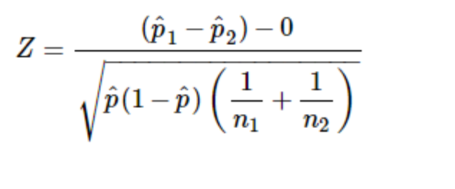
Two proportion test
Two independent sample – Large Sample(>=30)
Test Statistics

Slide 6
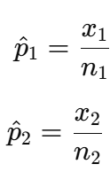

The sample proportions are calculated as:
The pooled proportion p-hat is calculated as:

Slide 7
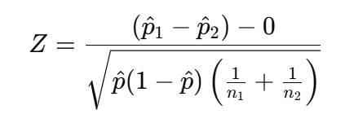
A/B Testing – calculations?
Sample 1 (old design A): n1=5013, x1=250 conversions
Sample 2 (new design B): n2=4987, x2=325 conversions

Slide 8
A/B Testing – conclusion
Calculated Z-value = -3.29
Critical Z-value = ±1.96
Since ∣Zcalculated∣=3.29>Zcritical=1.96, we reject the null hypothesis H0.
There is a statistically significant difference in the proportion of conversion rate for the two designs.
This suggests that website design has an influence on conversion rates.

Slide 9
Confidence interval and p-values

Slide 10
What is a Confidence Interval in Hypothesis Testing?
A confidence interval (CI) is a range of values that is likely to contain the true population parameter (like the mean or proportion) with a certain level of confidence (typically 95%).
Instead of saying, “The average weight is 70 kg,” we say: 👉 “We are 95% confident the average weight lies between 67 and 73 kg.”
It provides more information than a point estimate and helps in decision-making.

Slide 11

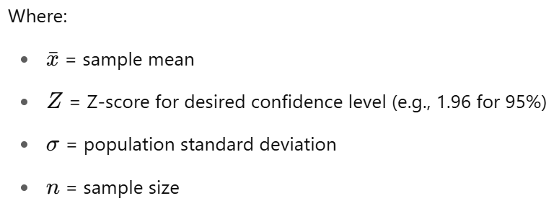
Formula
Z Confidence Interval (when population standard deviation is known)

Slide 12
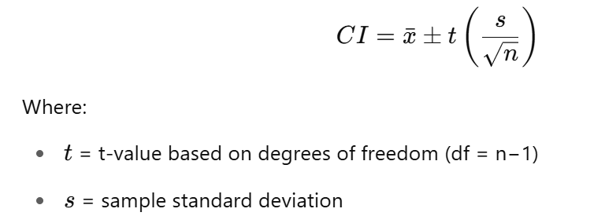
t Confidence Interval (when population standard deviation is unknown)

Slide 13
Solved Example – Z-Test CI
Problem:
A sample of 100 students has an average score of 75. The population standard deviation is 10. Find the 95% confidence interval for the true mean.

Slide 14
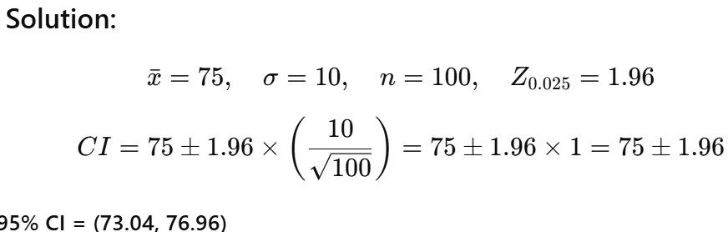
Solved Example – Z-Test CI
Problem:
A sample of 100 students has an average score of 75. The population standard deviation is 10. Find the 95% confidence interval for the true mean.

Slide 15
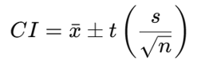
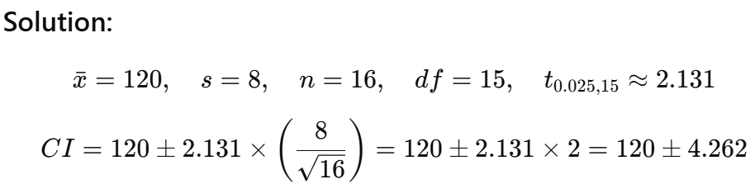

Solved Example – t-Test CI
Problem: A sample of 16 patients has an average blood pressure of 120. The sample standard deviation is 8. Find the 95% confidence interval assuming a t-distribution.

Slide 16
p-values

Slide 17
What is a p-value in Hypothesis Testing?
p-value = How likely is this result if nothing unusual is happening?
High p-value → Normal result
Low p-value → Unusual result
Small p-value = Strong evidence against the null hypothesis

Slide 18
What is a p-value in Hypothesis Testing?
p-value = How likely is this result if nothing unusual is happening?
High p-value → Normal result
Low p-value → Unusual result
Small p-value = Strong evidence against the null hypothesis
If p ≤ 0.05 → Reject null hypothesis
If p > 0.05 → Do not reject null hypothesis

Slide 19
Example:
A company claims their average delivery time is 30 minutes. You collect data and find the average is 34 minutes. After running a hypothesis test, your p-value = 0.01. What does it mean?
Interpretation:
Ho: average delivery time = 30 mins
If H₀ (delivery time is 30 mins) were true, there's only a 1% chance of getting a result like 34 mins or more extreme.
Now, Since p = 0.01 < 0.05, we reject H₀.
We conclude that the actual delivery time is significantly different from 30 mins.

Slide 20
MCQ
Q1. p=0.03 → ?
A) Accept H₀
B) Reject H₀
Q2. CI=(48,52), μ₀=53 → ?
A) Reject H₀
B) Accept H₀
Q3) p=0.07, α=0.05 → ?
A) Reject H₀
B) Fail to reject H₀

Slide 21
MCQ
Q1. p=0.03 → ?
A) Accept H₀
B) Reject H₀ ✅
Q2. CI=(48,52), μ₀=53 → ?
A) Reject H₀ ✅
B) Accept H₀
Q3) p=0.07, α=0.05 → ?
A) Reject H₀
B) Fail to reject H₀ ✅

Slide 22
Session Summary
In this session, we have discussed about:
Understand A/B testing
Confidence interval role in hypothesis testing
Concept of p-values in statistical tests

Slide 23
Reference Links
How to perform A/B Testing in Python
Introduction to Hypothesis Testing
Frequently asked hypothesis testing interview questions and answers – part 1
Frequently asked hypothesis testing interview questions and answers – part 2
Frequently asked hypothesis testing interview questions and answers – part 3
Sampling methods guide
How to Collect Data Effectively: Methods, Questionnaire Design, and Data Sources Explained
Probability Distributions in Python
Step-by-Step Guide to Two-Sample Z-Test for Large Samples (Population SD Known)

Slide 24

THANK YOU
For any Query:
Website- www.onlinecu.in
Helpline no.: 1800 121 388 800

